Slide 1
EcoPower Home
M&I-ENG 670 Team 9
Temirkhan Jaurov, Sarthak Raj, Aaron Akkara Bhargava Chinnakotla, Bagdat Koilybayev
Prof. Nehal Patel
Fall 2023
Notes:
Bagdat

Slide 2





Project Team and Project Introduction
Bagdat
Bhargava
Sarthak
Aaron
Temirkhan
Notes:
Everyone introduce

Slide 3
Project Scope, Objectives & Purpose
Scope : This project aims to design and construct a sustainable “EcoPower Home” which incorporates cutting edge sustainable design with a holistic approach to green living, aiming to set a new standard for scalable eco-friendly residences
Objectives : We aim to design, construct & deliver a 3000 sq. ft residential space complete with outdoor areas and a garage that is net energy zero. In addition to the energy savings achieved through using renewables we target lower construction cost by using alternate materials this ensures scalability.
Purpose :The purpose of this project is to design and construct a sustainable eco house that serves as a model for environmentally friendly living.
Notes:
Bagdat/Temir

Slide 4
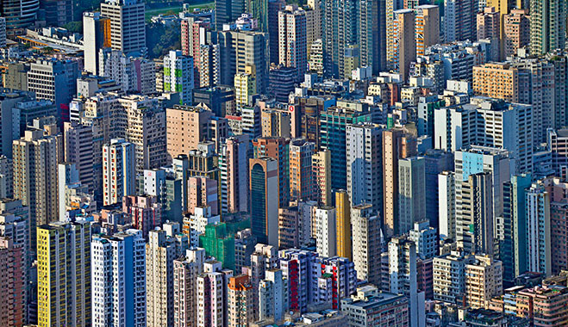

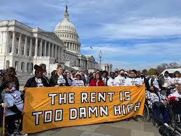
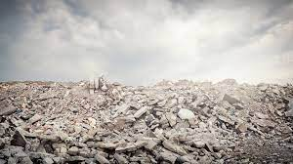
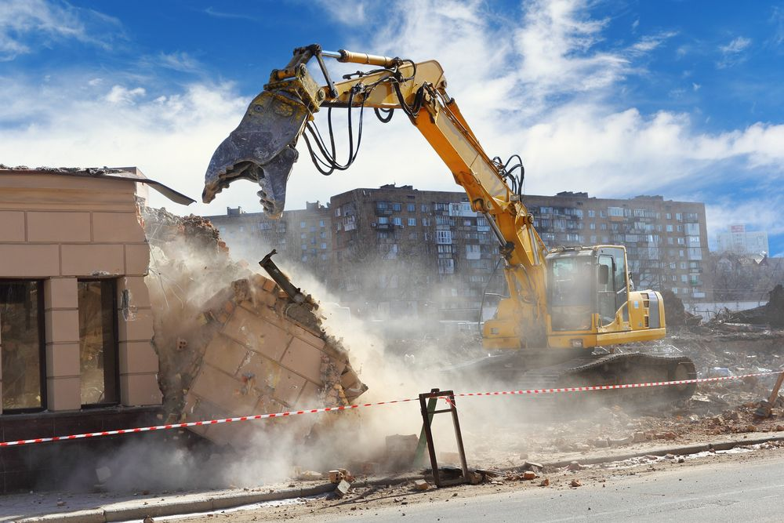

Problems?
Notes:
Aaron (Enablers?)

Slide 5
Project Overview
Aaron have a look tomorrow
Notes:
Aaron Ramsdale

Slide 6
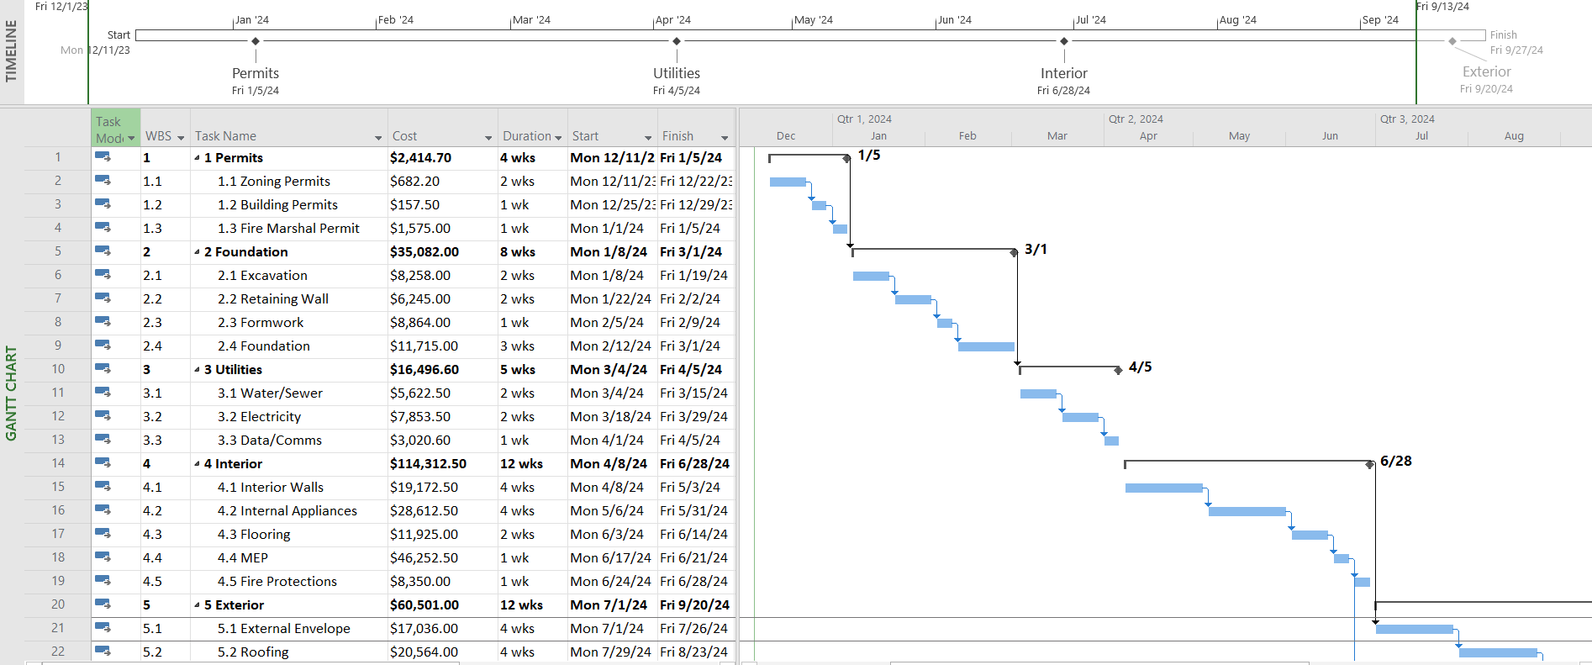
Work Breakdown Structure
Notes:
Aaron

Slide 7

Schedule Management
key milestones
Notes:
Bagdat

Slide 8
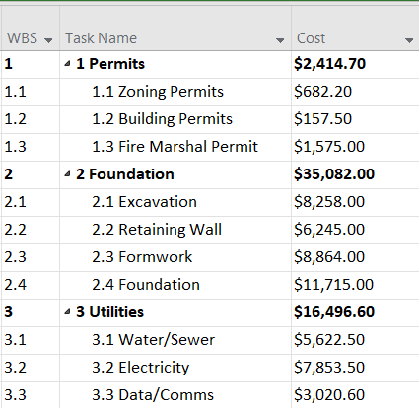
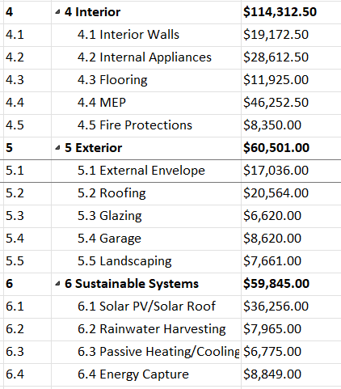
Cost Breakdown Structure
Notes:
Sarthak Determine the amount of cost required to complete project work. you don’t get paid, if you don’t show earned value. Usually earned value is done during key milestone such as: preliminary design review (PDR), critical design review (CDR), test readiness review (TRR). In the real world you will see management pushing on holding key milestone reviews, since its associated with invoicing for payment.
Schedule Performance Index: are we ahead or behind schedule
Cost Performance Index: are we under or over budget
Est. To Completion: what will be spend on remaining project
Est. At Completion: what will be spent on whole project
https://docs.google.com/spreadsheets/d/1TiGugCJULn8F-yr2tAJ9NesWcIQIGsrTv0rKW6hHT3U/edit?usp=sharing

Slide 9
Risk Assessment
Type of Risk | Risk Owner | Root Cause | Outcome | Proposed risk Treatment Actions to mitigate risk | Likelihood | Likelihood value | Consequence | Consequence value | Likelihood & Consequence | Target Risk Rating | Rank(L*C)
Weather-related delays | Project Manager | Unpredictable weather | Project delays, potential cost overruns | Schedule flexibility, monitor weather forecasts and invest in weather resistant construction methods | Likely | 4 | Major | 4 | L4,C4 | L1,C4 | 16
Environmental impact | Environmental consultant | Lack of environmental analysis | Reputational damage, legal issues | Environmental impact assessments, consult with experts | Likely | 4 | Major | 4 | L4,C4 | L1,C4 | 16
Material Shortages | Supply chain Manager | Supply chain disruptions | Delays, increased costs | Diversify suppliers, maintain a buffer stock on critical materials, and regular supply chain monitoring | possible | 3 | Major | 4 | L3,C4 | L1,C4 | 12
Design Flaws | Lead Designer | Insufficient research | Revisions, delays, cost Overruns | Conduct through research and engage in iterative design processes | possible | 3 | Moderate | 3 | L3,C3 | L1,C3 | 9
Regulatory compliance | Compliance Manager | Inadequate Understanding, changes in local building codes or regulations | Fines, rework and delays in approvals | Hire experts to ensure compliance, regular checks on regulations | unlikely | 2 | Moderate | 3 | L2,C3 | L1,C3 | 6
Labor Shortages | Project Manager | Market conditions, skill gap | Delays, increased labor costs | Cross train workers, collaborate with multiple labor sources | unlikely | 2 | Moderate | 3 | L2,C3 | L1,C3 | 6
Notes:
CEO of USA Bhargawa

Slide 10
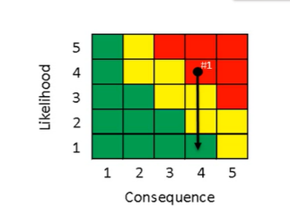
Risk Management
Risk: Weather Related delays
Root Cause: If there is unpredictable weather during the construction phase of the ECO house
Outcome: Then it may result in project delays due to adverse weather conditions.
Steps | Mitigation plan | Owner | Likelihood & Consequence
1 | Implement an early warning system that regularly monitors weather forecasts and provides real-time updates. | Project Manager | L4,C4
2 | Build flexibility into the construction schedule to account for potential weather-related delays. | Project Manager | L3,C4
3 | Develop a contingency plan that outlines specific actions to be taken in the event of adverse weather conditions. | Project Manager | L2,C4
4 | Collaborate with meteorological experts or services to gain specialized insights into regional weather patterns. | Project Manager | L2,C1
Notes:
Bhargawa

Slide 11
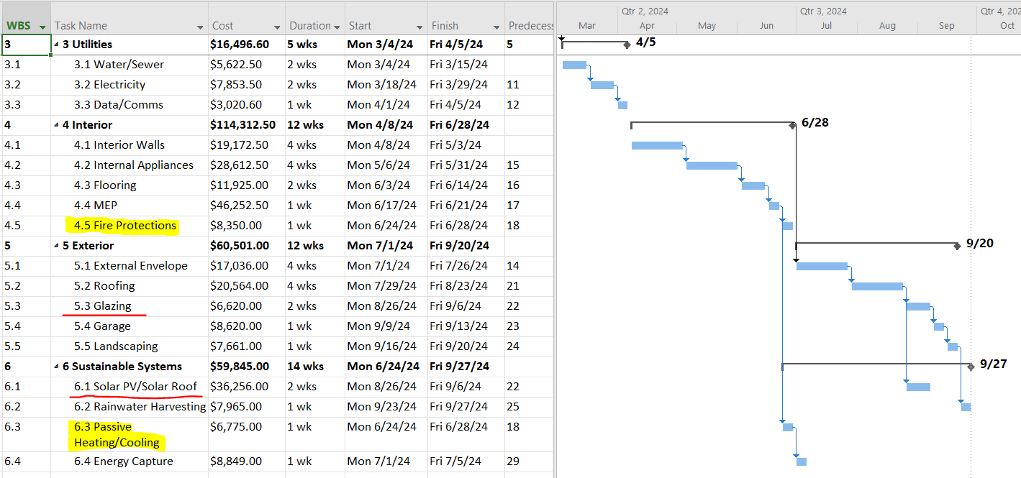
Recovery of the Schedule
Outsourcing non-critical activities to other teams/vendors
Frequent process updates, critical path monitoring, and adaptive re-plan
Examine near-critical path tasks for potential resource optimization: Supplies/warehouse , Resource Reallocation (allocating additional resources to critical path tasks) Fast-Tracking, Overtime
Parallel tasking: Installation of Sustainable Systems during Interior Construction
Notes:
Temir Determine the amount of cost required to complete project work. you don’t get paid, if you don’t show earned value. Usually earned value is done during key milestone such as: preliminary design review (PDR), critical design review (CDR), test readiness review (TRR). In the real world you will see management pushing on holding key milestone reviews, since its associated with invoicing for payment.
Schedule Performance Index: are we ahead or behind schedule
Cost Performance Index: are we under or over budget
Est. To Completion: what will be spend on remaining project
Est. At Completion: what will be spent on whole project
https://docs.google.com/spreadsheets/d/1TiGugCJULn8F-yr2tAJ9NesWcIQIGsrTv0rKW6hHT3U/edit?usp=sharing

Slide 12
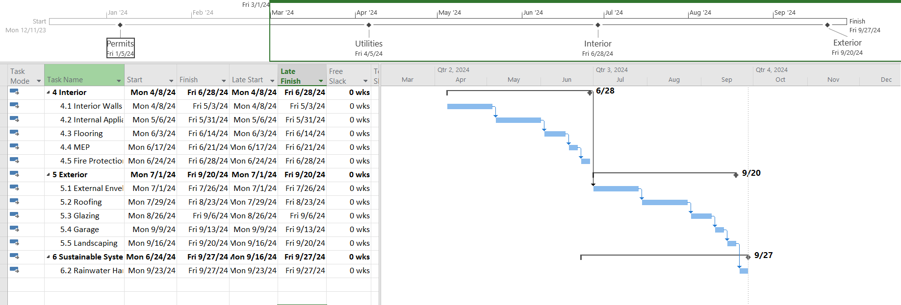
Critical Path
Notes:
Aaron

Slide 13
Questions?

Slide 14
Thank you!

